Slide 1

Spring Data
Dima Ionut Daniel

Slide 2
Contents
What is Spring Data?
Features
JPA
Architecture
Spring Data JPA
Conclussion
Bibliography

Slide 3

What is Spring Data?
Spring Data aims to significantly improve the implementation of data access layers by reducing the effort to the amount that's actually needed.
Spring Data provides a familiar and consistent Spring-based programming model for NoSQL and relational stores while retaining store-specific features and capabilities.

Slide 4
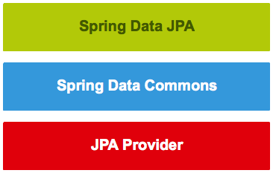
What is Spring Data? (cont.)
Spring Data JPA is not a JPA provider.
It adds an extra layer of abstraction on the top of our JPA provider.
The repository layer of our application contains three layers:
Spring Data JPA provides support for creating JPA repositories
Spring Data Commons provides the infrastructure
The JPA Provider implements the Java Persistence API

Slide 5
Features
Features:
Sophisticated support to build repositories based on Spring and JPA
Support for Querydsl predicates and thus type-safe JPA queries
Transparent auditing of domain class
Pagination support, dynamic query execution, ability to integrate custom data access code
Validation of @Query annotated queries at bootstrap time
Support for XML based entity mapping
JavaConfig based repository configuration by introducing @EnableJpaRepositories

Slide 6
JPA
An entity is a persistent domain object.
Each entity class generally represents a single database table.
An instance of such a class contains the data of a single table row.
The entity manager manages the entities of the application.
A persistence unit specifies all entity classes, which are managed by the entity managers of the application.
Each persistence unit contains all classes representing the data stored in a single database.

Slide 7
JPA (cont.)
JPA has 2 methods for creating database queries:
Java Persistence Query Language (JPQL)
Criteria API
The queries written by using these technologies do not deal directly with database tables.
Queries are written over the entities of the application and their persistent state.
This ensures that the created queries are portable and not tied to a specific database schema or database provider.

Slide 8
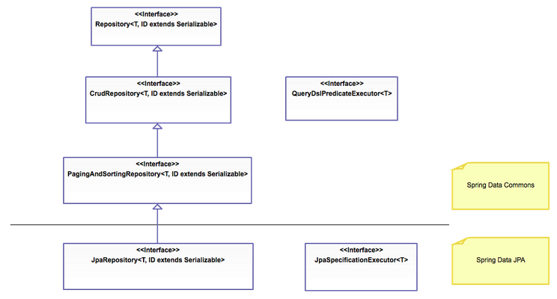
Architecture
Repository Hierarchy

Slide 9
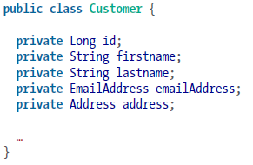
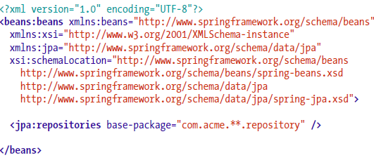

Spring Data JPA
In order to create the DAL we need to define Spring Data Repository interfaces.
To trigger the autodiscovery of the interfaces declared, we use either the <repositories /> element of the store-specific XML namespace or the related @EnableRepositories annotation in case we’re using JavaConfig.

Slide 10

Spring Data JPA (cont.)
The method declaration was inspected by the infrastructure and parsed, and a store-specific query was derived eventually.
If the queries become more complex we can use the @Query annotation.
The queries can even be externalized into a properties file—$store-named-queries.properties, located in META-INF—where $store is a placeholder for jpa, mongo,neo4j, etc.
The key has to follow the convention of $domainType.$methodName.

Slide 11
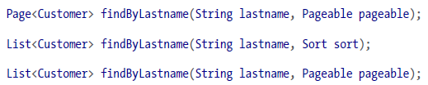
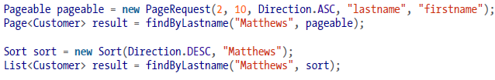
Spring Data JPA (cont.)
Pagination and Sorting:
If the number of results returned from a query grows significantly, we can use pagination.
Spring Data provides a pagination API that can be used with the repositories.
We can use the pagination functionality with the repository by simply adding a Pageable as a method parameter.
The implementation for Pageable is PageRequest.
If we don’t need pagination functionality, but plain sorting only, add a Sort parameter to the method signature; if we want pagination and sort we need to use Sort object on Pageable.

Slide 12
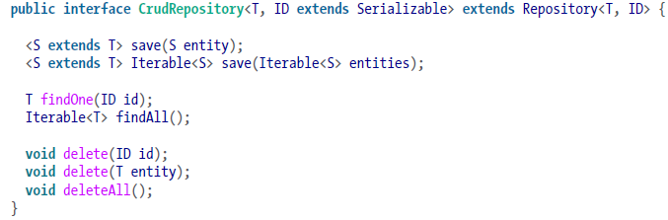
Spring Data JPA (cont.)
Repositories:
To derive the queries, we had to extend a Spring Data–specific marker interface: Repository.
Repository: A plain marker interface to let the Spring Data infrastructure pick up user-defined repositories.
CrudRepository: extends Repository and adds basic persistence methods like saving, finding, and deleting entities.
PagingAndSortingRepositories: extends CrudRepository and adds methods for accessing entities page by page and sorting them by given criteria.

Slide 13
Conclussion
Provides finder methods out of the box.
Useful features like paging, sorting are provided.
Easy to use.
Documented

Slide 14

Bibliography
http://projects.spring.io/spring-data-jpa
Oreilly – Spring Data
http://www.petrikainulainen.net/spring-data-jpa-tutorial/

Slide 15
Questions ?

